Slide 1
EE 74099 / EN 74099 Research Project
Project Title: Vision Based Navigation System for Indoor Robots
Progress Presentation – 7
09.06.2019
Under the Supervision of : Dr. WGCW Kumara
And Eng. Abdul Cadar
Team Members:
ANFM. Begum - SEU/IS/13/EG/002
GSU. Ahmadh - SEU/IS/13/EG/011
IIS. Prema Sri - SEU/IS/13/EG/032

Slide 2
Progress on object detection and tracking
From various methods available for object detection, we experimented the following methods and concluded the possibility of their usage for our purpose.
SIFT
GoTurn

Slide 3
SIFT
Stands for Scale Invariant Feature Transform
We can work with single sample image in SIFT.
Steps followed to get object detection
Get features from sample image and query image
Match the parameters of both images which are extracted by SIFT(). We can set minimum match count.
If we get good matches, create a border around the object.

Slide 4
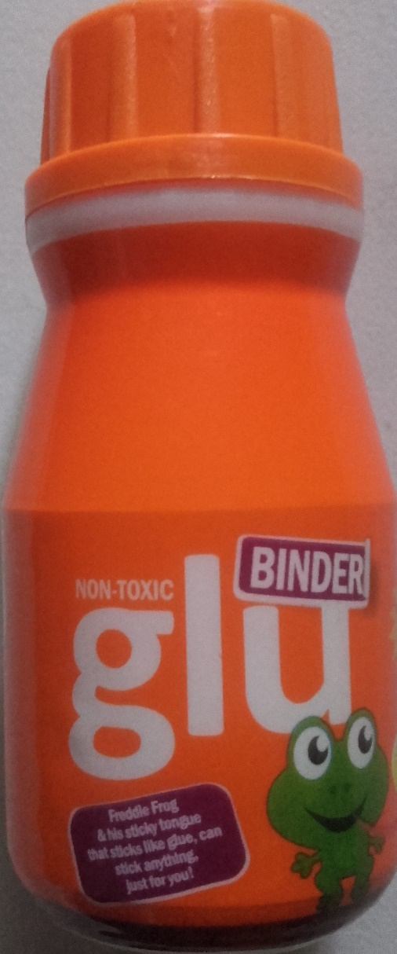
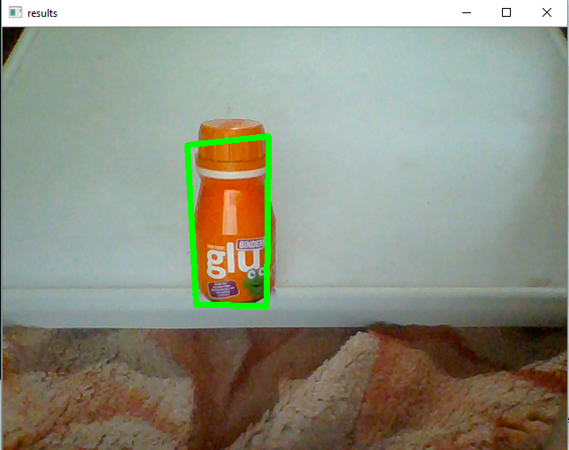
Figure 2: Train Image
Figure 3: Query Image

Slide 5
Issues in SIFT
Even though it is a good method to detect presence of an object in an image frame, it can only be used for fixed object as it detect based on feature matching. When the object’s orientations get changed, detection fails severly.
Thus, this method failed to get enlisted in our To-be-used list.

Slide 6
GOTURN
Following explanation is an excerpt from https://www.learnopencv.com/goturn-deep-learning-based-object-tracking/
GOTURN, short for Generic Object Tracking Using Regression Networks, is a Deep Learning based tracking algorithm.
Most tracking algorithms are trained in an online manner. In other words, the tracking algorithm learns the appearance of the object it is tracking at runtime.
Therefore, many real-time trackers rely on online learning algorithms that are typically much faster than a Deep Learning based solution.
GOTURN changed the way we apply Deep Learning to the problem of tracking by learning the motion of an object in an offline manner. The GOTURN model is trained on thousands of video sequences and does not need to perform any learning at runtime.

Slide 7
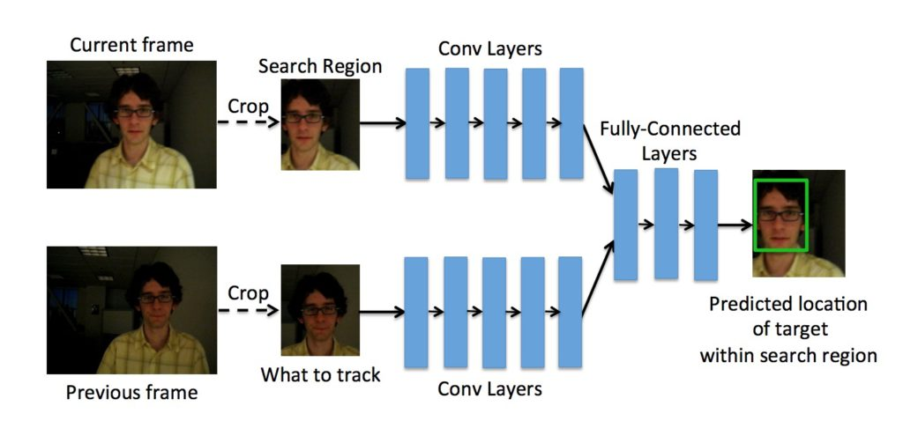
GOTURN Architecture
Figure shows the architecture of GOTURN. As mentioned before, it takes two cropped frame as input. Notice, the previous frame, shown at the bottom, is centered and our goal is the find the bounding box for the current frame shown on the top.
Both frames pass through a bank of convolutional layers. The layers are simply the first five convolutional layers of the CaffeNet architecture. The outputs of these convolutional layers (i.e. the pool5 features) are concatenated into a single vector of length 4096. This vector is input to 3 fully connected layers. The last fully connected layer is finally connected to the output layer containing 4 nodes representing the top and bottom points of the bounding box.

Slide 8
Issues in GOTURN
After successfully setting up our system to work with GOTURN, we experimented it on a live feed of webcam to track few objects. And following are the issues we found to be on our way of choosing this for our purpose.
This method is a pre-trained method. It has a set of objects already trained. When we track a new object it works fine as long as the frame doesn’t come across a known object to the network. For Example, this is very good with face tracking. When we try to track the palm, it tracks very well until the palm passes the face. When the tracking box passes the face, it sticks to the face and start tracking the face.
Stops tracking when object go out of frame
Accuracy of tracking was very limited for new objects.

Slide 9
Next,
We decided to train our detection network and experimenting the success rate. Based on which we will choose a method to carry on with the process.
Now, we are setting up YOLO object detection method and training our custom object classifier with it with the help of Tensorflow.
As it requires a lot of processing power and thus time for training object detection neural network and other dependencies to be installed on the system, we are setting up our pc to do the experiment.
Later on, once the training is done, we will test it on a simulator video.

Slide 10
Thank You

